Slide 1

The Real Estate Portal
DOĞUKAN GÜLER: 17000252
ALEYNA YILMAZ: 21000166
FATİH ÇAKIR: 21000128
Group No: 5

Slide 2

THE OVERVIEW
The Introduction
Project Management
Overall Description
Functional Requirements
Nonfunctional Requirements
User Interface
Conclusion

Slide 3

THE INTRODUCTION
Purpose:
Real estate search portal is a website designed to facilitate transactions such as real estate search, purchase, sale, rental and evaluation. This portal allows users to view, compare and query properties available in local or international markets.
System Scope:
The system scope includes a description of the functions and features that the portal offers. System scope is determined by the portal's goals, audiences, requirements, constraints, and assumptions.

Slide 4

Operating Environment:
The operating environment refers to the hardware, software, network and security components on which the portal runs.
Design and Implementation:
Design and implementation constraints are factors that affect the development and operation of the portal. Design and implementation constraints ensure that the portal complies with technical, business, legal and ethical standards.

Slide 5
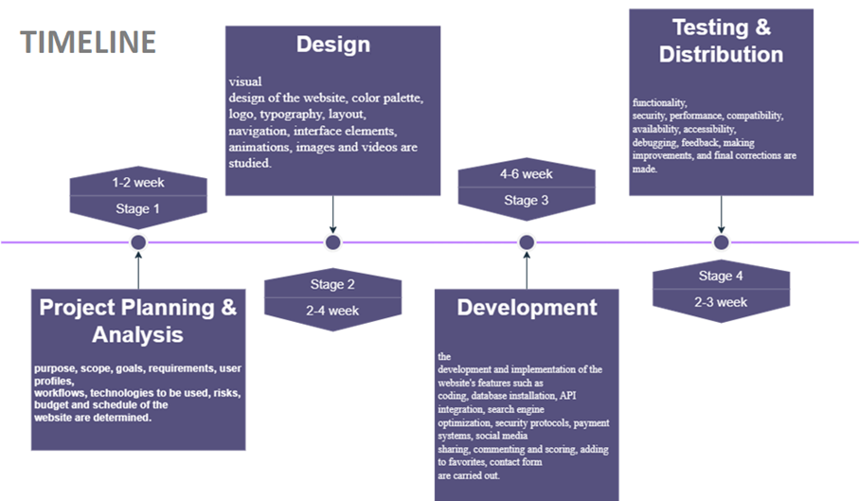
PROJECT MANAGEMENT

Slide 6
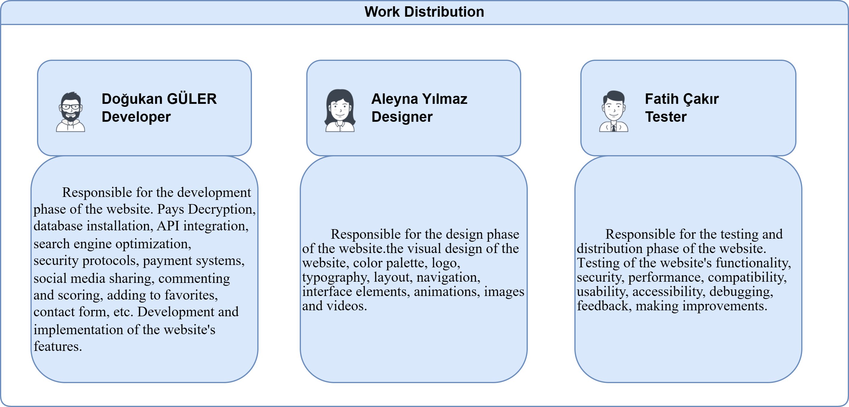

Slide 7

OVERALL DESCRIPTION
SYSTEM ARCHITECTURE DIAGRAM
USE CASE DIAGRAM
CLASS DIAGRAM
MODULAR HIERARCHY DIAGRAM

Slide 8
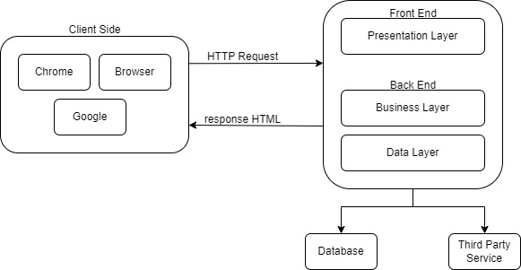
x
SYSTEM ARCHITECTURE
DIAGRAM

Slide 9
USE CASES
Use case 1: The user enters the portal's website, enters the desired location, property type, price range, number of rooms, square meters and other criteria in the search box, clicks the search button, the portal lists the properties suitable for the user, the user examines the list, compares the properties he likes, adds to the favourites adds, saves, shares or contacts advertisers.
Use case 2: The user opens the portal, activates the location service, views properties near him, marks properties on the map, reads property details, watches property photos or videos, sees property reviews or ratings, sends a message to the advertiser if he likes the property, or calls.

Slide 10
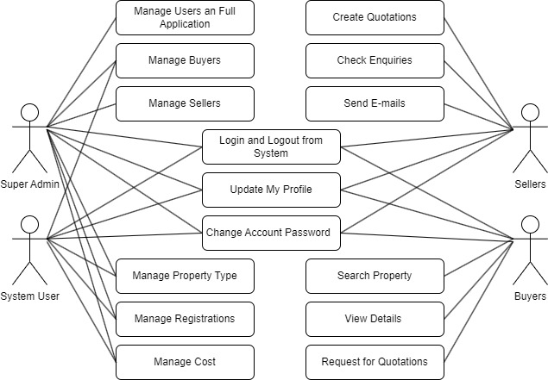
x
USE CASE DIAGRAM

Slide 11
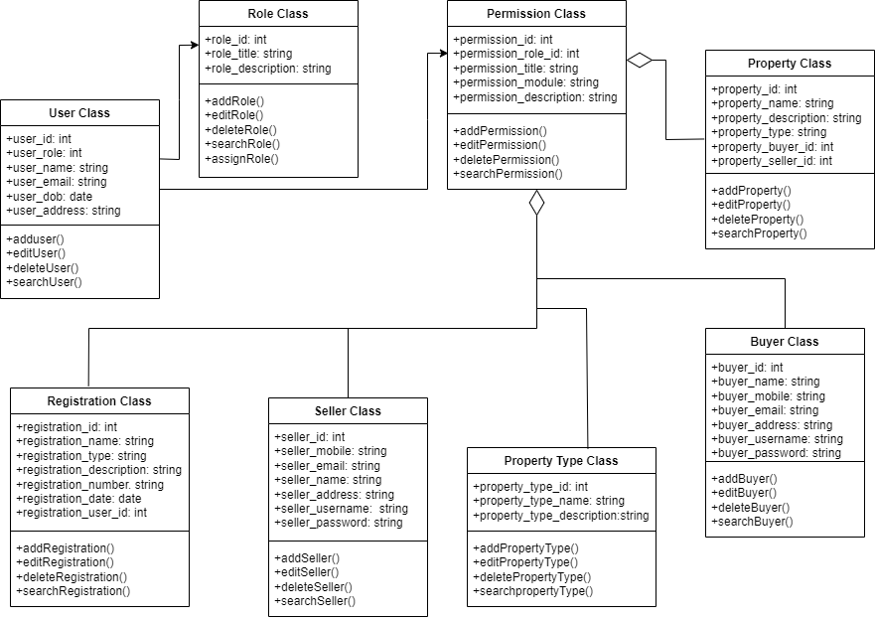
CLASS DIAGRAM

Slide 12
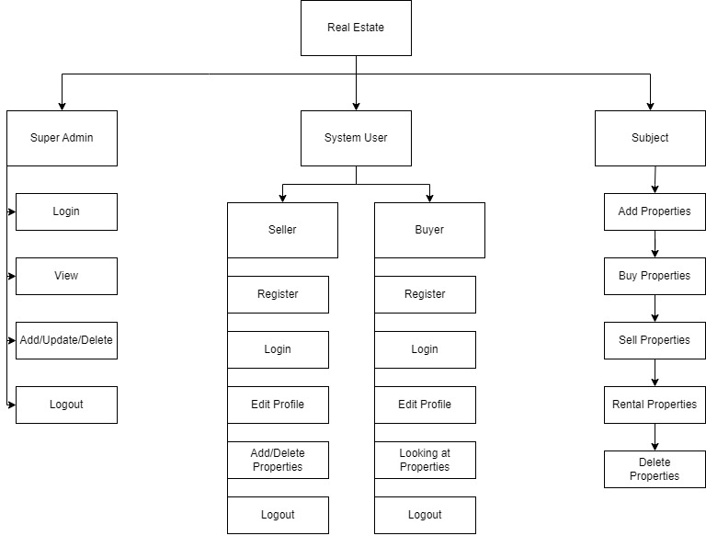
x
MODULAR HIERARCHY DIAGRAM

Slide 13
FUNCTIONAL REQUIREMENTS
User Requirements
REQ-1: Users can register and log in.
REQ-2: Users can manage their account.
REQ-3: Users can reset or update their passwords.
REQ-4: Users can use two-factor authentication.
REQ-5: Users can have the authority to review other users’ profiles.
REQ-6: Users can delete their accounts and their data if they want.

Slide 14
1.1 Buyer Requirements
• REQ-1: Buyer can search for properties and narrow down results with various filtering options.
• REQ-2: Buyer can add properties they like to favorite and access them easily later.
• REQ-3: The buyer can pay using secure payment methods.
1.2 Seller Requirements
• REQ-1: The seller can create a property listing and enter relevant information.
• REQ-2: The seller can edit or delete existing listings.
• REQ-3: The seller can review the statistics for listings
• REQ-4: The seller can start the sale transaction and receive payment.
• REQ-5: The sellers can display their properties on the location.
1.3 Admin Requirements
• REQ-1: The admin can create, edit, or close new or current user accounts.
• REQ-2: The admin can filter or delete inappropriate content.
• REQ-3: The admin can display and analyze general system statistics.
• REQ-4: The admin can reach database and display user data.
• REQ-5: The admin can check system backup operations.

Slide 15
NONFUNCTIONAL REQUIREMENTS
System Requirements
The website should load quickly.
The website should be open and accessible 24/7.
Security Requirements
The website should have an SSL certificate and protect the data of users.
The website should have a firewall which provides protection from DDoS attacks.

Slide 16
Usability Requirements
The website should have a user-friendly interface.
The website should work properly on the mobile platform, as well.
The website should have a live support assistant which 24/7 open.
Compatibility Requirements
The website should be compatible with different internet browsers and devices.
Maintenance
The system should update and maintain the website regularly.
The system should backup system data and being recoverable regularly.

Slide 17
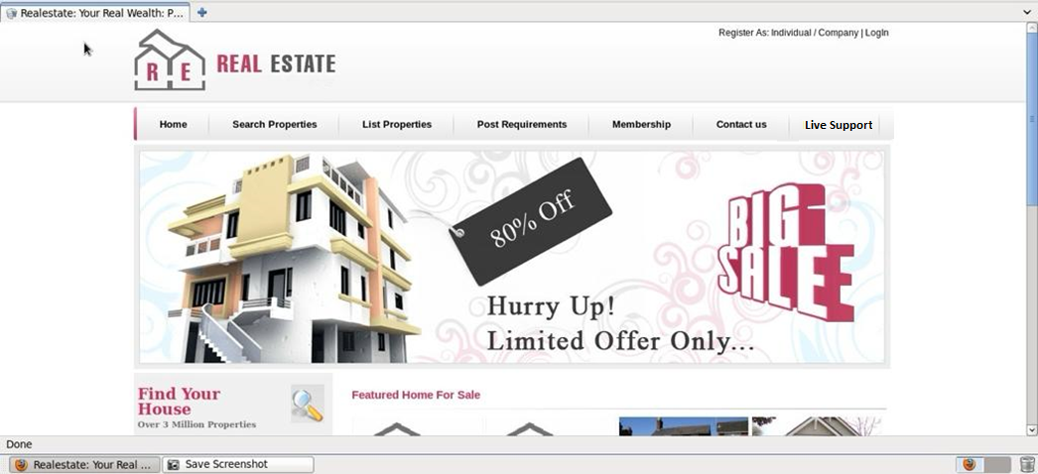
User Interface

Slide 18
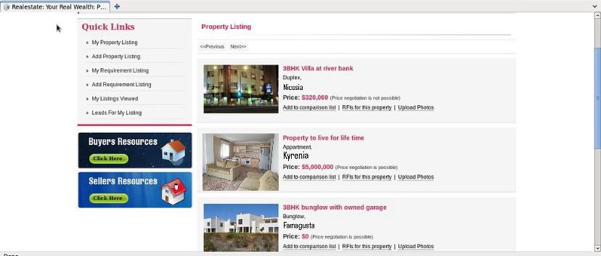

Slide 19
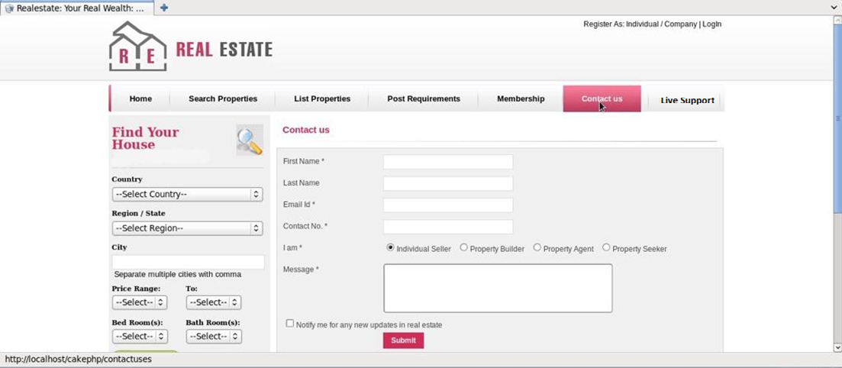

Slide 20

Conclusion
This report is a summary of the issues we pay attention to in making a real estate agent web application. In this report, we presented the design and development process of a real estate agent web application, as well as the content, target audience, competitive situation, legal obligations and revenue model of the web site.

